Slide 1


Sales Insights - Data Analysis Project using Tableau
By – Aryavardhan Pateriya
https://github.com/Aryavardhan02
https://www.linkedin.com/in/aryavardhan-pateriya-342008204/

Slide 2
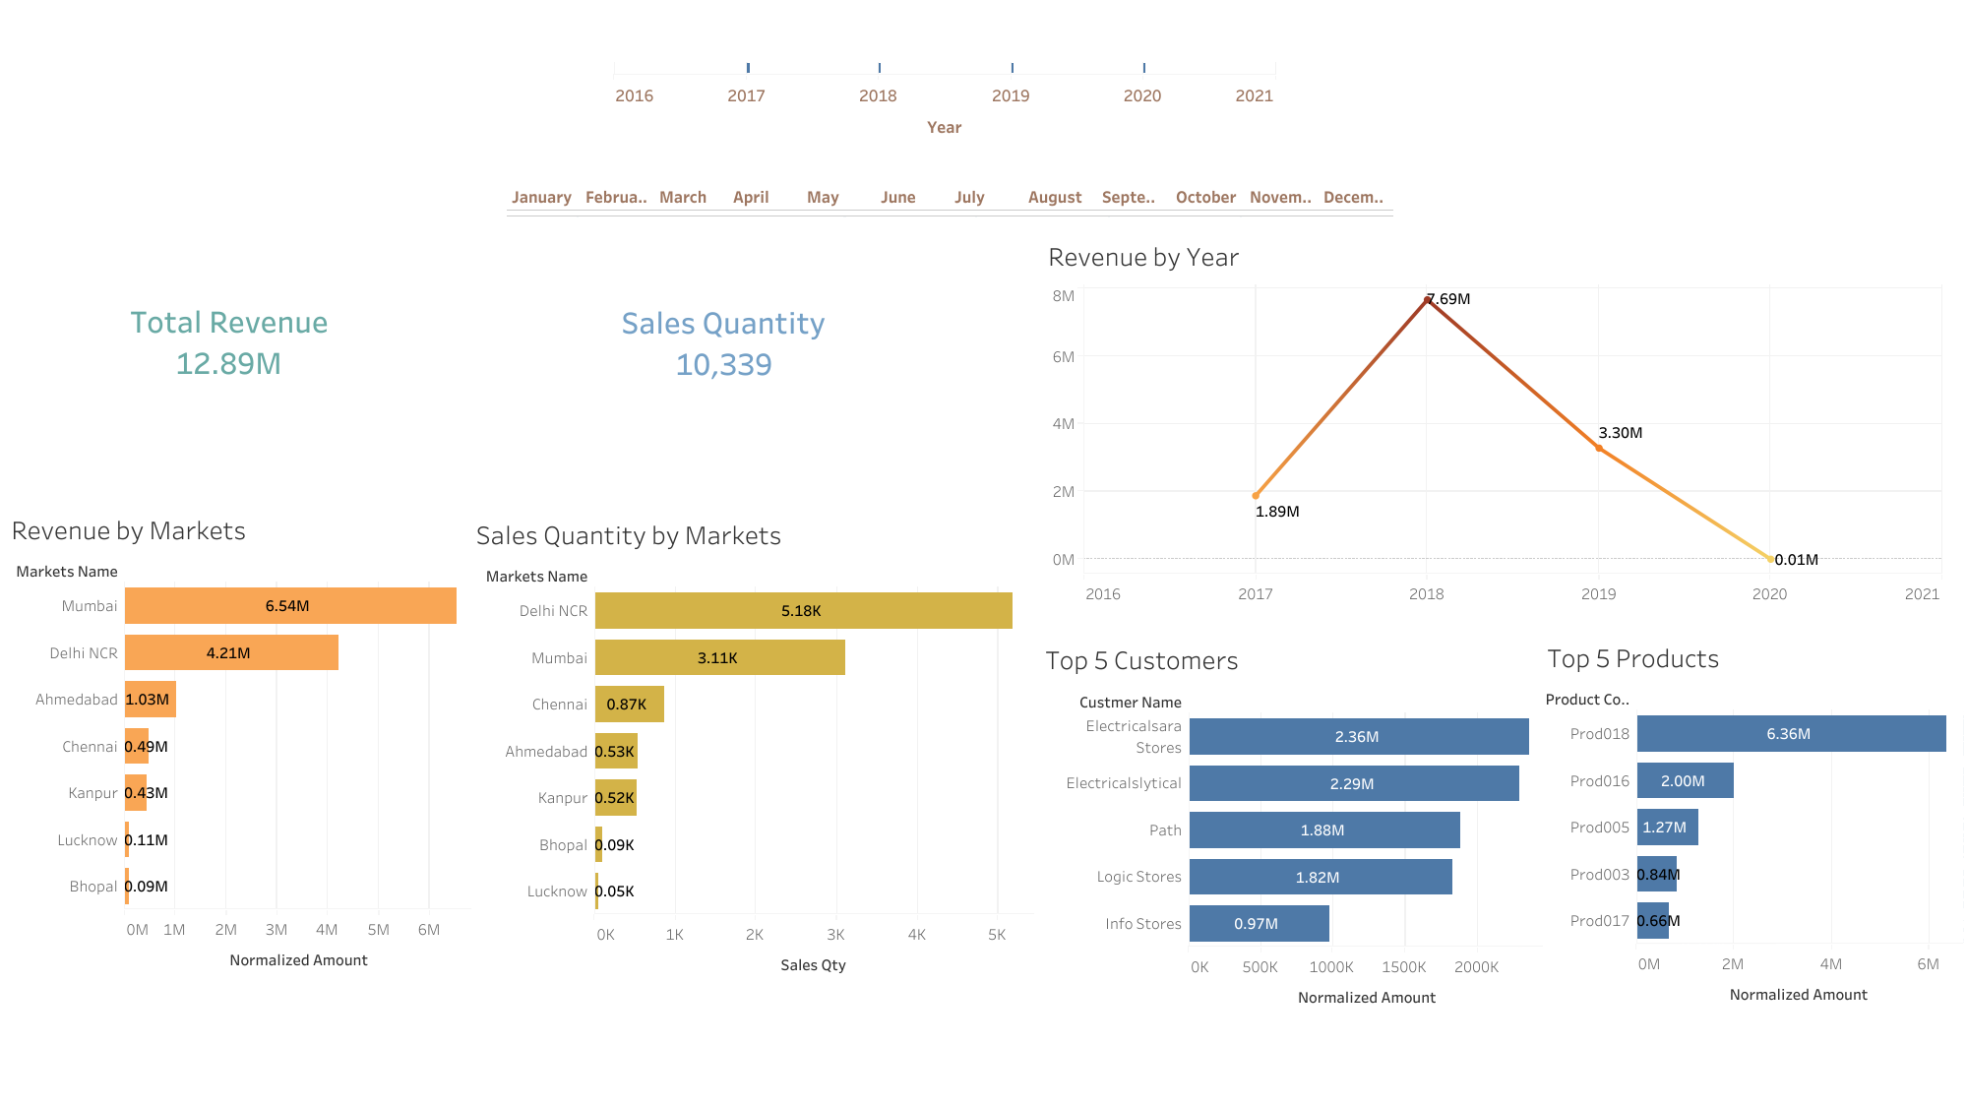

Slide 3
